Slide 1
THE WEBSITE PRESENTATION
FOR
THE DANDY BREWING COMPANY

Slide 2
The Purpose of the Website
The purpose of this website to show people how amazing your beer is and where they can find it.
Introduce people to your brewery and its offerings who are looking for great beer in the friendly and social space that you have created.
To inform local communities and the province in a whole, about having the original small-batch breweries, here, in Calgary, Alberta.
This website is a business card of the company in the Internet and not only.
People will be aware of your new full-service tasting room.
This will not cause you to lose business due to mis- or uninformed potential customers in the future.

Slide 3
The Design of the Website
The website has the age validation form that appears first. Only persons the age of 21 may enter this site.
The website fits all of the content on a single page in order not to overwhelmed potential customers by information.
The background of the website displays two big glasses of beer. The background performed in beer color as well as the whole website.
These two things reflect an activity of your company. It is a brewing company that are offering its brewery assortment.
On the front of the website, the name of your company is displayed in the form of big letters and the year when your company was established.
It allows people to keep in mind the name of the company. Not to mention, it also allows to search your company by name in the Internet so it is easy to remember it.

Slide 4
The Navigation Bar
The navigation bar is on the top of the website that will follow your potential customers through the website so easily. In other words, it is a map of the website.
The navigation bar consists of menu-buttons which has visual effect with hints. It creates a user-friendly interface that will guide people through the website.
The menu-buttons will redirect the customers to certain content they chose.

Slide 5
The Content
A caret-beer before the name of each section/content is placed that is being rotated and opened a certain content when user clicks on it.
It creates a user-friendly, even funny, interface and remind the customers about your company.
The content of the website: About Us, Beers, The Tasting Room, Where to find us, Artist in Residence, Story, and Contact Us.

Slide 6
The Content (continued)
About Us – says shortly about your company.
Beers – represents the full Dandy line up of exciting styles of beers.
The Tasting Room – offers a unique drinking menu and the amazing full lunch, dinner, and brunch menu plus tours in the tasting room.
Where to find us – shows where people can find out craft beer in Calgary (in stores, restaurants, and bars).
Artist in Residence – the other side is the social aspect of beer is a sponsor program for artists that are a huge part of beer culture.
Story – says when and how you started your business.
Contact Us – where to find you.

Slide 7
The Progress Bar and Footer
The progress bar is presented as an octopus that is being rotated when user is scrolling up and down.
In addition to this, the octopus is a button to back to the main page.
It makes the website more user-friendly to customers and creates relax/free atmosphere.
The address of your company is placed in the footer of the website to remind once again the customers where to find you.
The footer has social media icons to follow you on Twitter, Facebook, and Instagram.

Slide 8
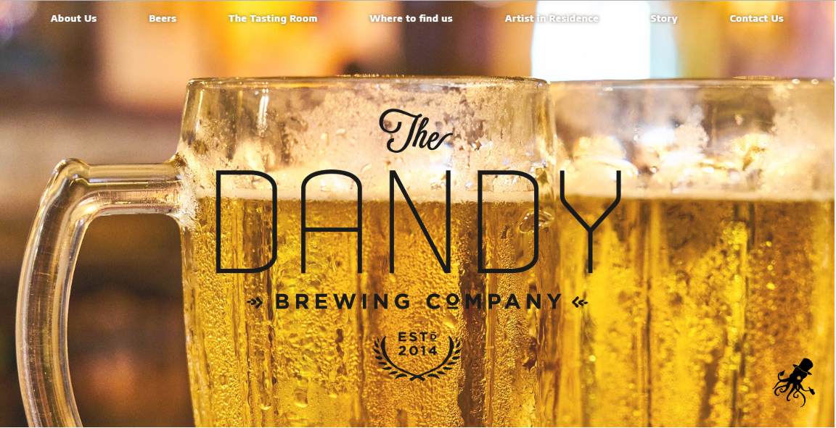
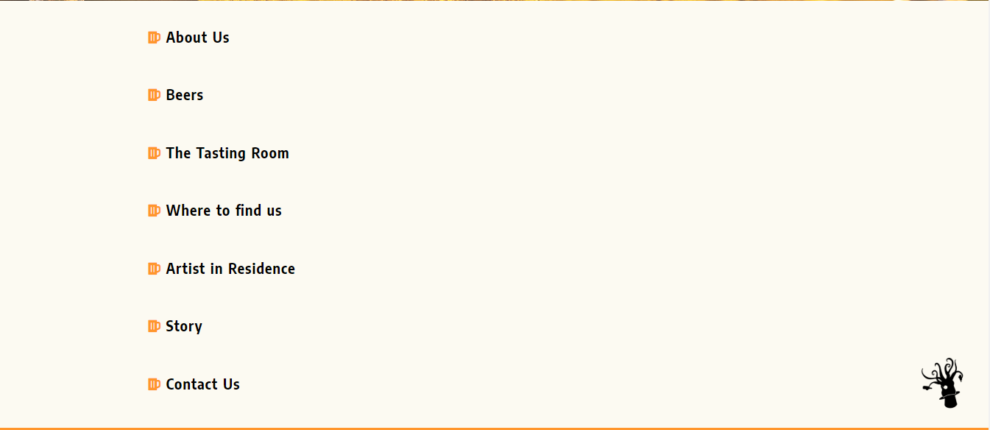
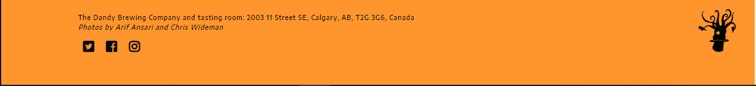
Finally, the website itself !
The website’s URL: https://dandybeer.000webhostapp.com/

Slide 9
The website and presentation was done by
Roman Nepyyvoda

